Slide 1

Modern Microservices
Application Advice
Daniel Williams (dwilliams@kenzan.com)
2018-08-23
https://github.com/kenzanlabs/modernmicroservices

Slide 2
About
Kenzan
We are a software engineering and digital consulting firm that has been helping clients Make Next Possible for over a decade:
Core offerings Application Development, Platform as a service, cloud virtualization, platform engineering, consulting services and business transformation.
Primary Clients Multi billion dollar companies and media/content providers such as Thompson Reuters, Charter & Cablevision Locations Providence (RI), New York (NY), Denver (CO), Los Angeles (CA), and a London presence
Founded in 2004.
Full Service Consulting Firm Architecture, front and back end development, business analysis and DevTest.
Cloud Virtualization Experts And Enablers AWS, Netflix stack, enterprise architecture and beyond.
DevOps Leadership Platform builds, continuous delivery and scalable resourcing.
Veterans of the Media Industry Migrations, enterprise wide solutions, digital experts and thought leaders.
Employee focused Collaboration, communication and culture are key.

Slide 3


Agenda
Multiple Part Series Focusing on:
Platform & Infrastructure
Continuous Delivery
Continuous Integration
Application
Notes:
Talk a bit about:
We’re starting basic, but not “Cloud 101”
We’ll get more advanced in future sessions
Today, we’re keeping it high level
Ask questions throughout the session, don’t wait until the end

Slide 4
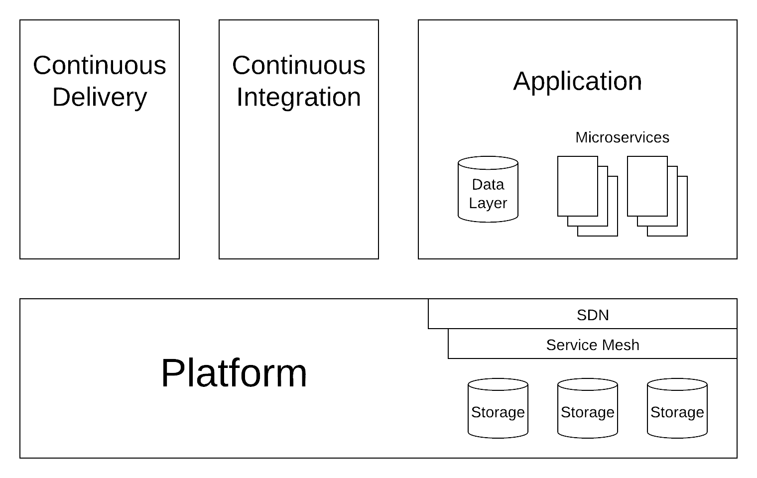
The Whole Picture

Slide 5
Version Control
Make sure everything is in version control. EVERYTHING!
Source code
Configs
Artifacts
Documentation

Slide 6
3. Configuration
… should be simple.
Option overload makes things hard to debug.
… should come from outside the app/container.
Environment variables
Service discovery

Slide 7
6. Processes
The applications should be stateless.
The in-process data should go into or out of a database or queue.
The control data should come from the environment (see 3).

Slide 8
8. Concurrency
Applications should be parallelizable.
Applications should be able to scale by making more copies.

Slide 9
9. Disposability
Quick startup & shutdown makes scaling efficient.
There shouldn’t be much (if any) global state to save on shutdown (see 6).
Processes will be terminated abruptly, make sure the application can handle it.
Notes:
Example from Spinnaker:
https://www.spinnaker.io/reference/architecture/

Slide 10
Application (Microservices)
Service Discovery
Sidecars
Add in to a microservice to provide support
e.g. health checks, service discovery client
Configuration from the Environment
No configuration in artifacts
Circuit Breaker Pattern

Slide 11
11. Logs
Log :allthethings:
but choose the correct logging level.
Use a logging library.
Use a log collection & aggregation service.

Slide 12
Code Walkthrough
https://github.com/kenzanlabs/modernmicroservices
https://github.com/cfree/js-interactive

Slide 13




Want to learn more?
Follow us!
@kenzanmedia
www.linkedin.com/company/kenzan-media
techblog.kenzan.com
www.facebook.com/kenzanmedia/

